Slide 1
Chapter 6: CPU Scheduling

Slide 2
Background
  CPU scheduling is the basis of multi-programming operating systems.
  By switching the CPU among processes, the operating system can make the computer more productive
  In this chapter, we introduce basic CPU-scheduling concepts and present several CPU-scheduling algorithms

Slide 3
Background
  Review the life cycle of a process in a single-processor
  A process is executed until it must wait, typically for the completion of some I/O request
  In a simple computer system, CPU time is wasted!
Objective of multiprogramming
  Having some process running at all times to maximize CPU utilization
  When one has to wait, takes the CPU away, gives to another
CPU scheduling
Notes:
In a simple computer system, the CPU then just sits idle. All this waiting time is wasted, no useful work is accomplished
With multiprogramming, we try to use this time productively. Several processes are kept in memory at one time. When one process has to wait, the operating system takes the CPU away from that process and gives the CPU to another process. This pattern continues. Every time one process has to wait, another process can take over use of the CPU

Slide 4

Basic Concepts
CPU–I/O Burst Cycle – Process execution consists of a cycle of CPU execution and I/O wait
CPU burst followed by I/O burst
Maximum CPU utilization obtained with multiprogramming
CPU burst distribution is of main concern
Notes:
Process alternate between these two states: process execution begins with a CPU burst. That is followed by an I/O burst, which is followed by another CPU burst, then another I/O burst, and so on

Slide 5
Review: Schedulers
Short-term scheduler (or CPU scheduler) – selects which process should be executed next and allocates CPU
  Short-term scheduler is invoked frequently (milliseconds)
  It must be fast, because of the short time between executions
Long-term scheduler (or job scheduler) – selects which processes should be brought into the ready queue
  Long-term scheduler is invoked infrequently (seconds, minutes), may be slow
  The long-term scheduler controls the degree of multiprogramming

Slide 6

CPU Scheduler
Short-term scheduler (or CPU scheduler) – selects from among the processes in ready queue, and allocates CPU to one of them
  Queue may be ordered in various ways
When can process scheduling take place?
Notes:
Note that the ready queue is not necessarily a first-in, first-out (FIFO) queue. As we shall see when we consider the various scheduling algorithms, a ready queue can be implemented as FIFO queue, a priority queue, a tree, or simply an unordered linked list

Slide 7
Scheduling Criteria
What criteria make sense?
CPU utilization – keep the CPU as busy as possible
Throughput – # of processes that complete their execution per time unit
Turnaround time – amount of time to execute a particular process: from time of submission to time of completion
Waiting time – amount of time a process has been waiting in the ready queue
  CPU scheduling algorithm affects only the amount of time that a process spends waiting in the ready queue
Response time – amount of time it takes from when a request was submitted until the first response is produced, not output (for time-sharing environment)
Difference between Turnaround time and Response time?
Notes:
Turnaround time------the sum of the periods spent waiting to get into memory, waiting in the ready queue, executing on the CPU, and doing I/O
Waiting time------The CPU scheduling algorithm does not affect the amount of time during which a process executes or does I/O.
Difference between Turnaround time and Response time: the former is limited by the speed of the output device

Slide 8
Scheduling Algorithm Optimization Criteria
Max CPU utilization
Max throughput
Min turnaround time
Min waiting time
Min response time

Slide 9

First- Come, First-Served (FCFS) Scheduling
FCFS: the process that requests the CPU first is allocated the CPU first
Process Burst Time
P₁ 24
P₂ 3
P₃ 3
Suppose that the processes arrive in the order: P₁ , P₂ , P₃
The Gantt Chart for the schedule is:
Waiting time for P₁ = 0; P₂ = 24; P₃ = 27
Average waiting time: (0 + 24 + 27)/3 = 17
Notes:
The implementation of the FCFS policy is easily managed with a FIFO queue
When a process enters the ready queue, its PCB is linked onto the tail of the queue. When the CPU is free, it is allocated to the process at the head of the queue

Slide 10

FCFS Scheduling (Cont.)
Suppose that the processes arrive in the order:
P₂ , P₃ , P₁
The Gantt chart for the schedule is:
Waiting time for P₁ = 6; P₂ = 0; P₃ = 3
Average waiting time: (6 + 0 + 3)/3 = 3
Much better than previous case
The average waiting time under the FCFS policy is often quite long
The FCFS scheduling algorithm is non-preemptive
Thus, the average waiting time under the FCFS policy is generally not minimal and may vary substantially if the processes’ CPU burst times vary greatly

Slide 11
Shortest-Job-First (SJF) Scheduling
Associate with each process the length of its next CPU burst
  Use these lengths to schedule the process with the shortest time
  When the CPU is available, it is assigned to the process that has the smallest next CPU burst
  See example in next slide
Moving a short process before a long one decreases the waiting time of the short process more that it increases the waiting time of the long process. Consequently, the average waiting time decreases

Slide 12

Example of SJF
ProcessArriva l Time Burst Time
P₁ 0.0 6
P₂ 2.0 8
P₃ 4.0 7
P₄ 5.0 3
SJF scheduling chart
Average waiting time = (3 + 16 + 9 + 0) / 4 = 7
If in FCFS, Average waiting time = (0 + 6 + 14 + 21) / 4 = 10.25
Notes:
By comparison, if we were using the FCFS scheduling scheme, the average waiting time would be 10.25 milliseconds

Slide 13
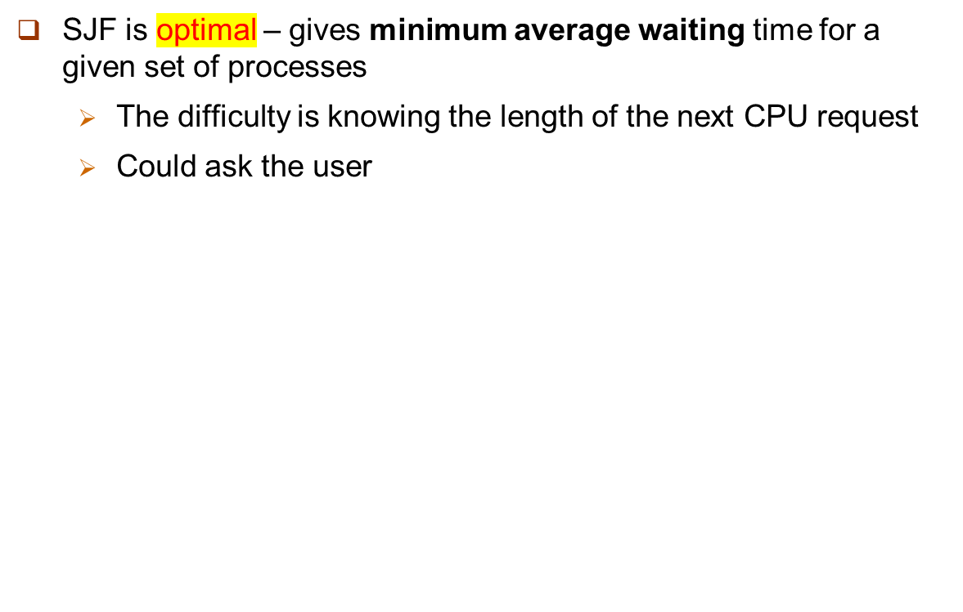
Shortest-Job-First (SJF) Scheduling

Slide 14
Shortest-remaining-time-first
The SJF algorithm can be either preemptive or non-preemptive
  Non-preemptive: Once the CPU has been allocated to a process, that process keeps the CPU until it releases the CPU, either by terminating or by requesting I/O
Preemptive SJF scheduling is also called shortest-remaining-time-first
  When a new process arrives at the ready queue while a previous process is still executing
  The next CPU burst of the newly arrived process may be shorter than what is left of the currently executing process
  A preemptive SJF algorithm will preempt the currently executing process

Slide 15

Example of Shortest-remaining-time-first
Now we add the concepts of varying arrival times and preemption to the analysis
ProcessA arri Arrival TimeT Burst Time
P₁ 0 8
P₂ 1 4
P₃ 2 9
P₄ 3 5
Preemptive SJF Gantt Chart
Average waiting time = [(10-1)+(1-1)+(17-2)+5-3)]/4 = 26/4 = 6.5 msec
Non-preemptive SJF would result in an average waiting time of 7.75 msec

Slide 16
Priority Scheduling
A priority number (integer) is associated with each process
The CPU is allocated to the process with the highest priority (smallest integer ≡ highest priority)
  Preemptive
    When a process arrives at the ready queue, its priority is compared with the priority of the currently running process.
    A preemptive priority scheduling preempt the CPU if the priority of the newly arrived process is higher than the priority of the currently running process.
  Non-preemptive
SJF is priority scheduling where priority is the inverse of next CPU burst time
See example in next slide
Notes:
A non-preemptive priority scheduling algorithm will simply put the new process at the head of the ready queue

Slide 17

Example of Priority Scheduling
ProcessA arri Burst TimeT Priority
P₁ 10 3
P₂ 1 1
P₃ 2 4
P₄ 1 5
P₅ 5 2
Priority scheduling Gantt Chart
Average waiting time = 8.2 msec
Notes:
In this text, we assume that low numbers represent high priority

Slide 18
Priority Scheduling
Problem ≡ Starvation – low priority processes may never execute in preemptive case
Solution ≡ Aging – gradually increasing the priority of processes that wait in the system for a long time

Slide 19
Round Robin (RR)
Similar to FCFS, but preemption is added to enable the system to switch between processes
Each process gets a small unit of CPU time (time quantum q), usually 10-100 milliseconds. After this time has elapsed, the process is preempted and added to the end of the ready queue.
Treat the ready queue as a FIFO queue of processes. New processes are added to the tail of the ready queue. The CPU scheduler picks the first process from the ready queue, sets a timer to interrupt after 1 time quantum, and dispatches the process
Timer interrupts every quantum to schedule next process

Slide 20
Round Robin (RR)
One of two things will then happen
If the process have a CPU burst of less than 1 time quantum
  Release the CPU voluntarily
  The scheduler will then proceed to the next process in the ready queue
  If the CPU burst of the currently running process is longer than 1 time quantum
  The timer will go off and will cause an interrupt to the operating system.
  A context switch will be executed, and the process will be put at the tail of the ready queue.
  The CPU scheduler will then select the next process in the ready queue.

Slide 21

Example of RR with Time Quantum = 4
Process Burst Time
P₁ 24
P₂ 3
P₃ 3
Arrive at time 0, time quantum = 4
The Gantt chart is:
Average waiting time: [(10-4) + (4-0) + (7-0) ] / 3 = 17/3 = 5.66
Typically, higher average turnaround than SJF, but better response
Notes:
Process P2 does not need 4 milliseconds, so it quits before its time quantum expires.

Slide 22

Time Quantum and Context Switch Time
The performance of the RR algorithm depends heavily on the size of the time quantum.
  q large ⇒ FCFS
  q small ⇒ results in a large number of context switch
  q should be large compared to context switch time, otherwise overhead is too high
Notes:
At one extreme, if the time quantum is extremely large, the RR policy is the same as the FCFS policy. In contrast, if the time quantum is extremely small, the RR approach can result in a large number of context switches

Slide 23
Multilevel Queue
A multilevel queue scheduling algorithm partitions the ready queue into several separate queues
The processes are permanently assigned to one queue,
  generally based on some property of the process, such as memory size, process priority, or process type.
Each queue has its own scheduling algorithm:
  foreground (interactive) – RR
  background (batch) – FCFS
Scheduling must be done between the queues:
  Fixed priority scheduling; (i.e., serve all from foreground then from background). Possibility of starvation. (See Example)
  Time slice – each queue gets a certain amount of CPU time which it can schedule amongst its processes; i.e., 80% to foreground in RR, and 20% to background in FCFS
Notes:
These two types of processes have different response-time requirements and so may have different scheduling needs. In addition, foreground processes may have priority over background processes.
Each queue has its own scheduling algorithm.

Slide 24

Multilevel Queue Scheduling
Notes:
No process in the batch queue, for example, could run unless the queues for system processes, interactive processes, and interactive editing processes are all empty
If an interactive editing process entered the ready queue while a batch process was running, the batch process would be preempted

Slide 25
Multilevel Feedback Queue
Allow a process to move between the various queues
Idea: separate processes according to the characteristic of their CPU bursts
  If a process uses too much CPU time, it will be moved to a lower-priority queue
  Leaves I/O-bound and interactive processes in the higher-priority queues
  In addition, a process that waits too long in a lower-priority queue may be moved to a higher-priority queue
    This form aging prevents starvation
Notes:
Multilevel queue: this setup has the advantage of low scheduling overhead, but it is inflexible

Slide 26

Example of Multilevel Feedback Queue
Three queues:
  Q₀ – RR with time quantum 8 milliseconds
  Q₁ – RR time quantum 16 milliseconds
  Q₂ – FCFS
Scheduling
  A new job enters queue Q₀ which is served FCFS
    When it gains CPU, job receives 8 milliseconds
    If it does not finish in 8 milliseconds, job is moved to queue Q₁
  If queue Q₀ is empty, at Q₁ job is again served FCFS and receives 16 additional milliseconds
    If it still does not complete, it is preempted and moved to queue Q₂
Notes:
The scheduler first executes all processes in queue 0. Only when queue 0 is empty it will execute processes in queue 1.
Similarly, processes in queue 2 will be executed only if queues 0 and 1 are empty.
A process that arrives for queue 1 will preempt a process in queue 2. A process in queue 1 will in turn be preempted by a process arriving for queue 0.

Slide 27
Priority-based Scheduling with preemption
For real-time scheduling, scheduler must support preemptive, priority-based scheduling
  But only guarantees soft real-time functionality
A process currently running on the CPU will be preempted if a higher-priority process available to run
For hard real-time must also provide ability to meet deadlines
Deadline: by which it must be serviced by the CPU
Notes:
The most important feature of a real-time operating system is to respond immediately to a real-time process as soon as that process requires the CPU. As a result, the scheduler for a real-time operating system must support a priority-based algorithm with preemption.
Recall that priority-based scheduling algorithms assign each process a priority based on its importance; more important tasks are assigned higher priorities than those deemed less important. If the scheduler also supports preemption, a process currently running on the CPU will be preempted if a higher-priority process available to run
%%%%%%%%%%%%%%%
Hard real-time systems must further guarantee that real-time tasks will be serviced in accord with their deadline requirements, and making such guarantees requires additional scheduling features.
Deadline: by which it must be serviced by the CPU
In the remainder of this section, we cover scheduling algorithms appropriate for hard real-time systems

Slide 28

Process Characteristics
Processes have characteristics: periodic------ process requires CPU at constant intervals
  Has fixed processing time t, deadline d, period p
  0 ≤ t ≤ d ≤ p
  Rate of periodic task is 1/p

Slide 29
Rate Monotonic Scheduling
The rate-monotonic scheduling algorithm schedules periodic tasks using a static priority policy with preemption.
If a lower-priority process is running and a higher-priority process becomes available to run, it will preempt the lower-priority process.
A priority is assigned based on the inverse of its period
  Shorter periods = higher priority;
  Longer periods = lower priority
  Rationale: assign a higher priority to tasks that require the CPU more often

Slide 30
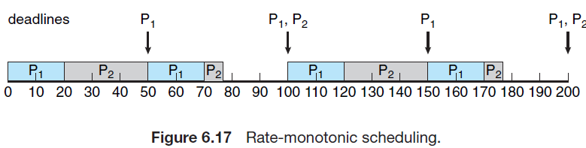
Example: Using Rate Monotonic Scheduling
Suppose P1 is assigned a higher priority than P2 because the period of P1 is shorter than that of P2.
Deadline is satisfied!
Period: P₁ = 50; P₂ = 100;
Processing time: t₁ = 20; t₂ = 35;
Deadline: complete its CPU burst by the start of its next period.

Slide 31
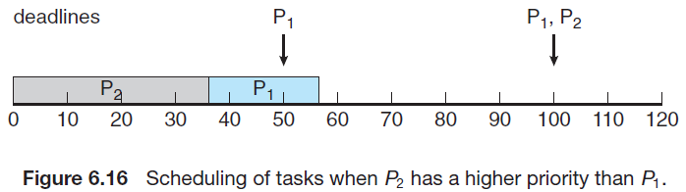
Example: Without Using Rate Monotonic Scheduling
Suppose P₂ is assigned a higher priority than P₁
P1 misses its first deadline at time 50
Period: P₁ = 50; P₂ = 100;
Processing time: t₁ = 20; t₂ = 35;
Deadline: complete its CPU burst by the start of its next period.
Notes:
Suppose we assign P2 a higher priority than P1. The execution of P1 and P2 in this situation is shown in Figure 6.16. As we can see, P2 starts execution first and completes at time 35. At this point, P1 starts; it completes its CPU burst at time 55. However, the first deadline for P1 was at time 50, so the scheduler has caused P1 to miss its deadline.

Slide 32
Earliest Deadline First Scheduling (EDF)
Priorities are dynamically assigned according to deadlines:
  the earlier the deadline, the higher the priority;
  the later the deadline, the lower the priority
What the difference between rate-monotonic scheduling and EDF?
  In EDF, priorities may have to be adjusted to reflect the deadline of the newly runnable process.
  However, in rate-monotonic scheduling, priorities are fixed

Slide 33
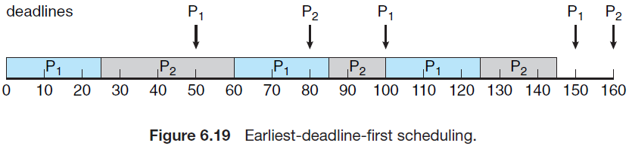
Earliest Deadline First Scheduling (EDF) (cont.)
Example: Earliest Deadline First Scheduling (EDF)
At time 50, P2 now has a higher priority than P1 because its next deadline (at time 80) is earlier than that of P1 (at time 100).
P2 is preempted at time 100 because P1 has an earlier deadline (time 150) than P2 (time 160).
Period: P₁ = 50; P₂ = 80;
Processing time: t₁ = 25; t₂ = 35;
Deadline: complete its CPU burst by the start of its next period.

Slide 34
Problem 01
Consider three processes, all arriving at time zero, with total execution time of 10, 20 and 30 units respectively.
Each process spends the first 20% of execution time doing I/O, the next 70% of time doing computation, and the last 10% of time doing I/O again.
The operating system uses a shortest-remaining-time-first scheduling algorithm and schedules a new process either when the running process gets blocked on I/O or when the running process finishes its compute burst.
Assume that all I/O operations can be overlapped as much as possible.
For what percentage of does the CPU remain idle?

Slide 35
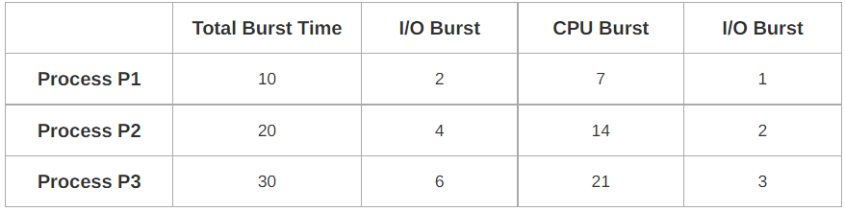
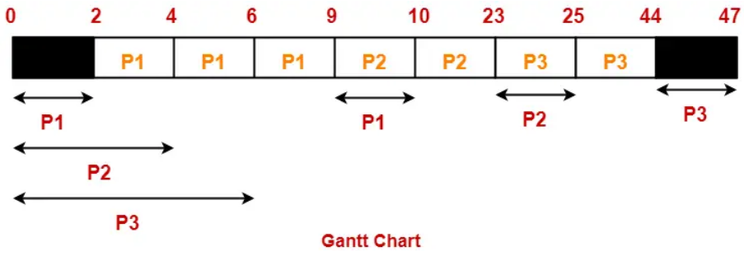
Problem 01 - Solution
According to question, we have
The scheduling algorithm used is Shortest-Remaining-Time-First:
Percentage of time CPU remains idle
= (5 / 47) x 100%
= 10.638%

Slide 36
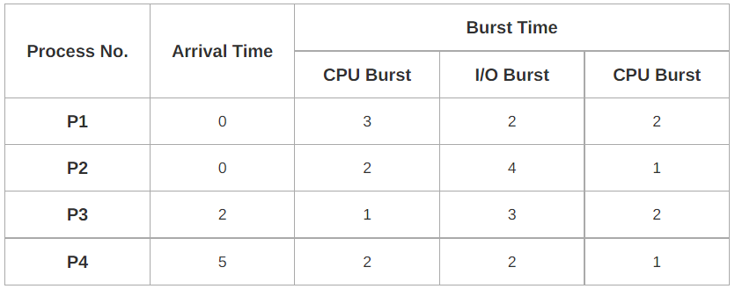
Problem 02 - Question
Consider the set of 4 processes whose arrival time and burst time are given below
If the CPU scheduling policy is Shortest Remaining Time First, calculate the average waiting time and average turn around time.

Slide 37
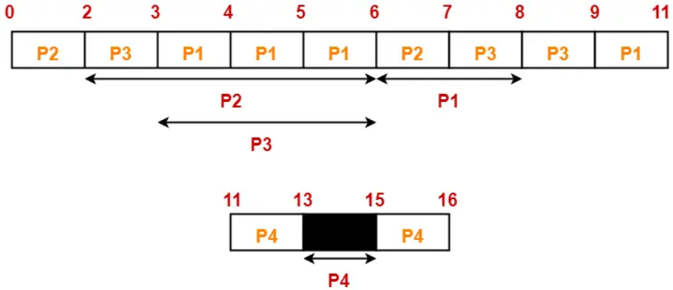
Problem 02 - Solution

Slide 38
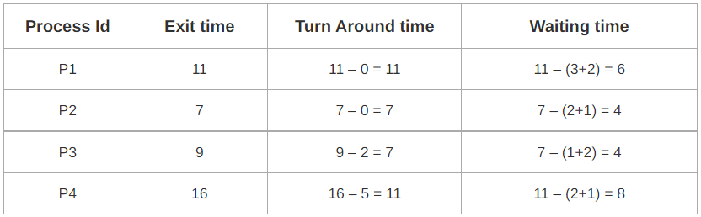
Problem 02 - Solution
Turn Around time = Exit time – Arrival time
Waiting time = Turn Around time – Burst time
Average Turn Around time = (11 + 7 + 7 + 11) / 4 = 36 / 4 = 9
Average waiting time = (6 + 4 + 4 + 8) / 4 = 22 / 5 = 4.4

Slide 39
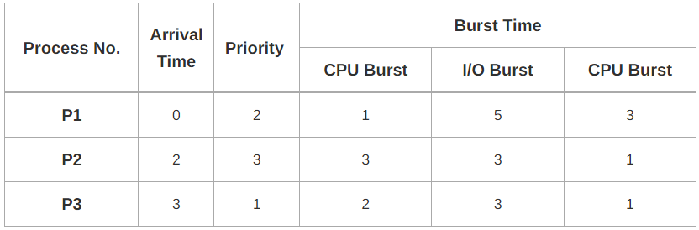
Problem 03 - Question
Consider the set of 4 processes whose arrival time and burst time are given below
If the CPU scheduling policy is Priority Scheduling, calculate the average waiting time and average turn around time. (Lower number means higher priority)

Slide 40
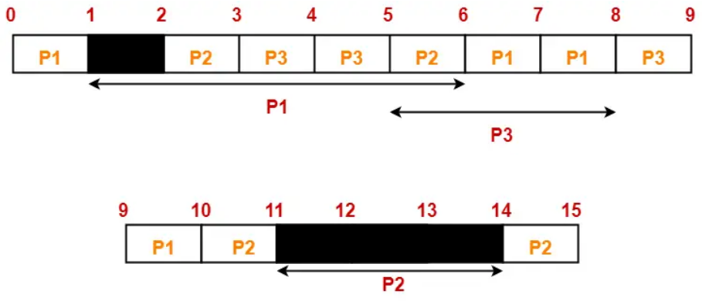
Problem 03 - Solution

Slide 41
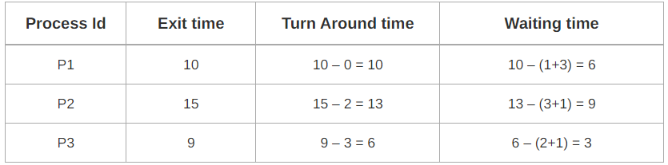
Problem 03 - Solution
Turn Around time = Exit time – Arrival time
Waiting time = Turn Around time – Burst time
Average Turn Around time = (10 + 13 + 6) / 3 = 29 / 3 = 9.67
Average waiting time = (6 + 9 + 3) / 3 = 18 / 3 = 6

Slide 42
Quiz 1
In a single-processor, multi-process system with multiple processes in the ready state, which of the following statement about processor scheduling is incorrect_____.
Processor scheduling can occur when a process ends.
Processor scheduling can occur after a new process is created.
Processor scheduling cannot occur while a process is in the critical section.
Processor scheduling can occur after a system call is completed and returns to user mode.

Slide 43
Quiz 2
Among the following events, those that may trigger the execution of the process scheduler are ( ).
I. The end of interrupt handling
II. Process voluntary blocking
III. Process termination
IV. Process's time slice expires
A. Only I, III
B. Only II, IV
C. Only III, IV
D. I, II, III, and IV

Slide 44
Quiz 3
The moments when processes P0, P1, P2, and P3 enter the ready queue, their priorities (the smaller the value, the higher the priority), and the CPU execution time are as shown in the table below.
Processes ArriveTime Priority CPU burst
P0 0ms 15 100ms
P1 10ms 20 60ms
P2 10ms 10 20ms
P3 15ms 6 10ms
If the system adopts a priority-based preemptive process scheduling algorithm, then from the moment at 0 ms when scheduling begins until all four processes have finished running, the total number of times process scheduling occurs is:
A. 4
B. 5
C. 6
D. 7

Slide 45
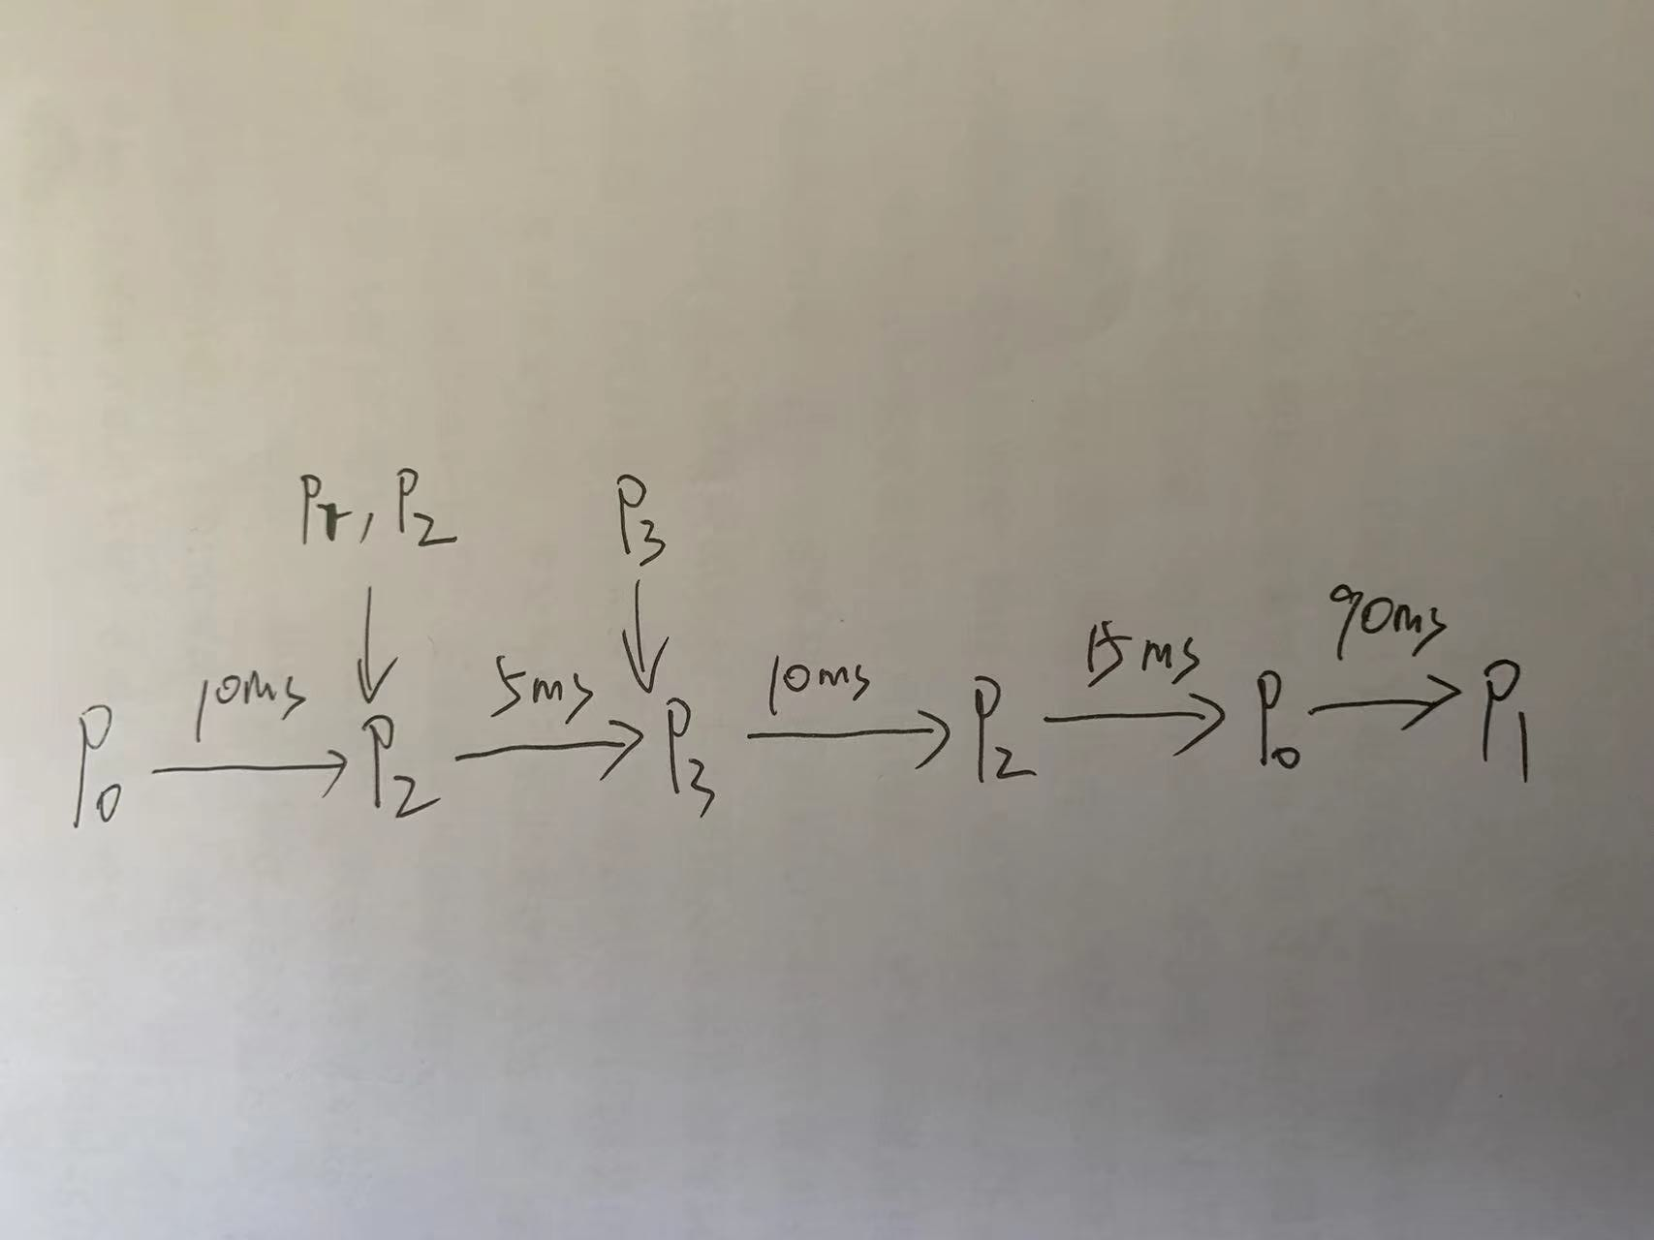
Quiz 3 - Solution

Slide 46
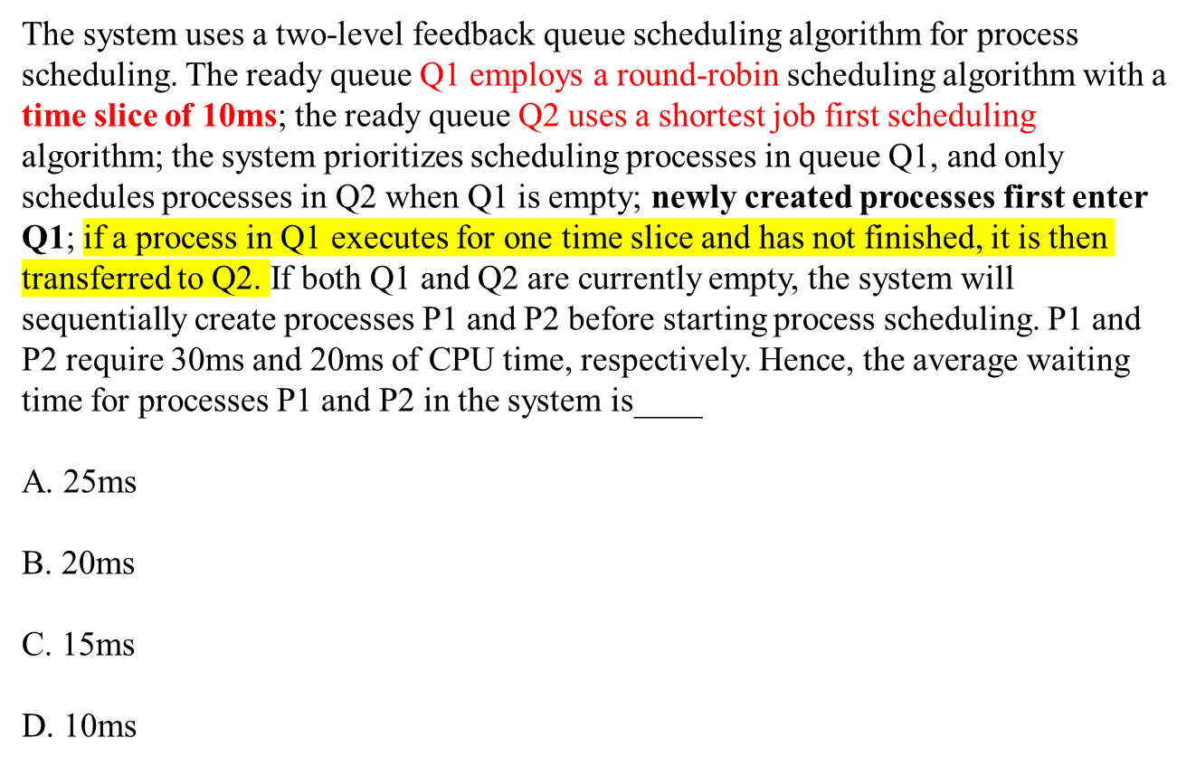
Quiz 4

Slide 47
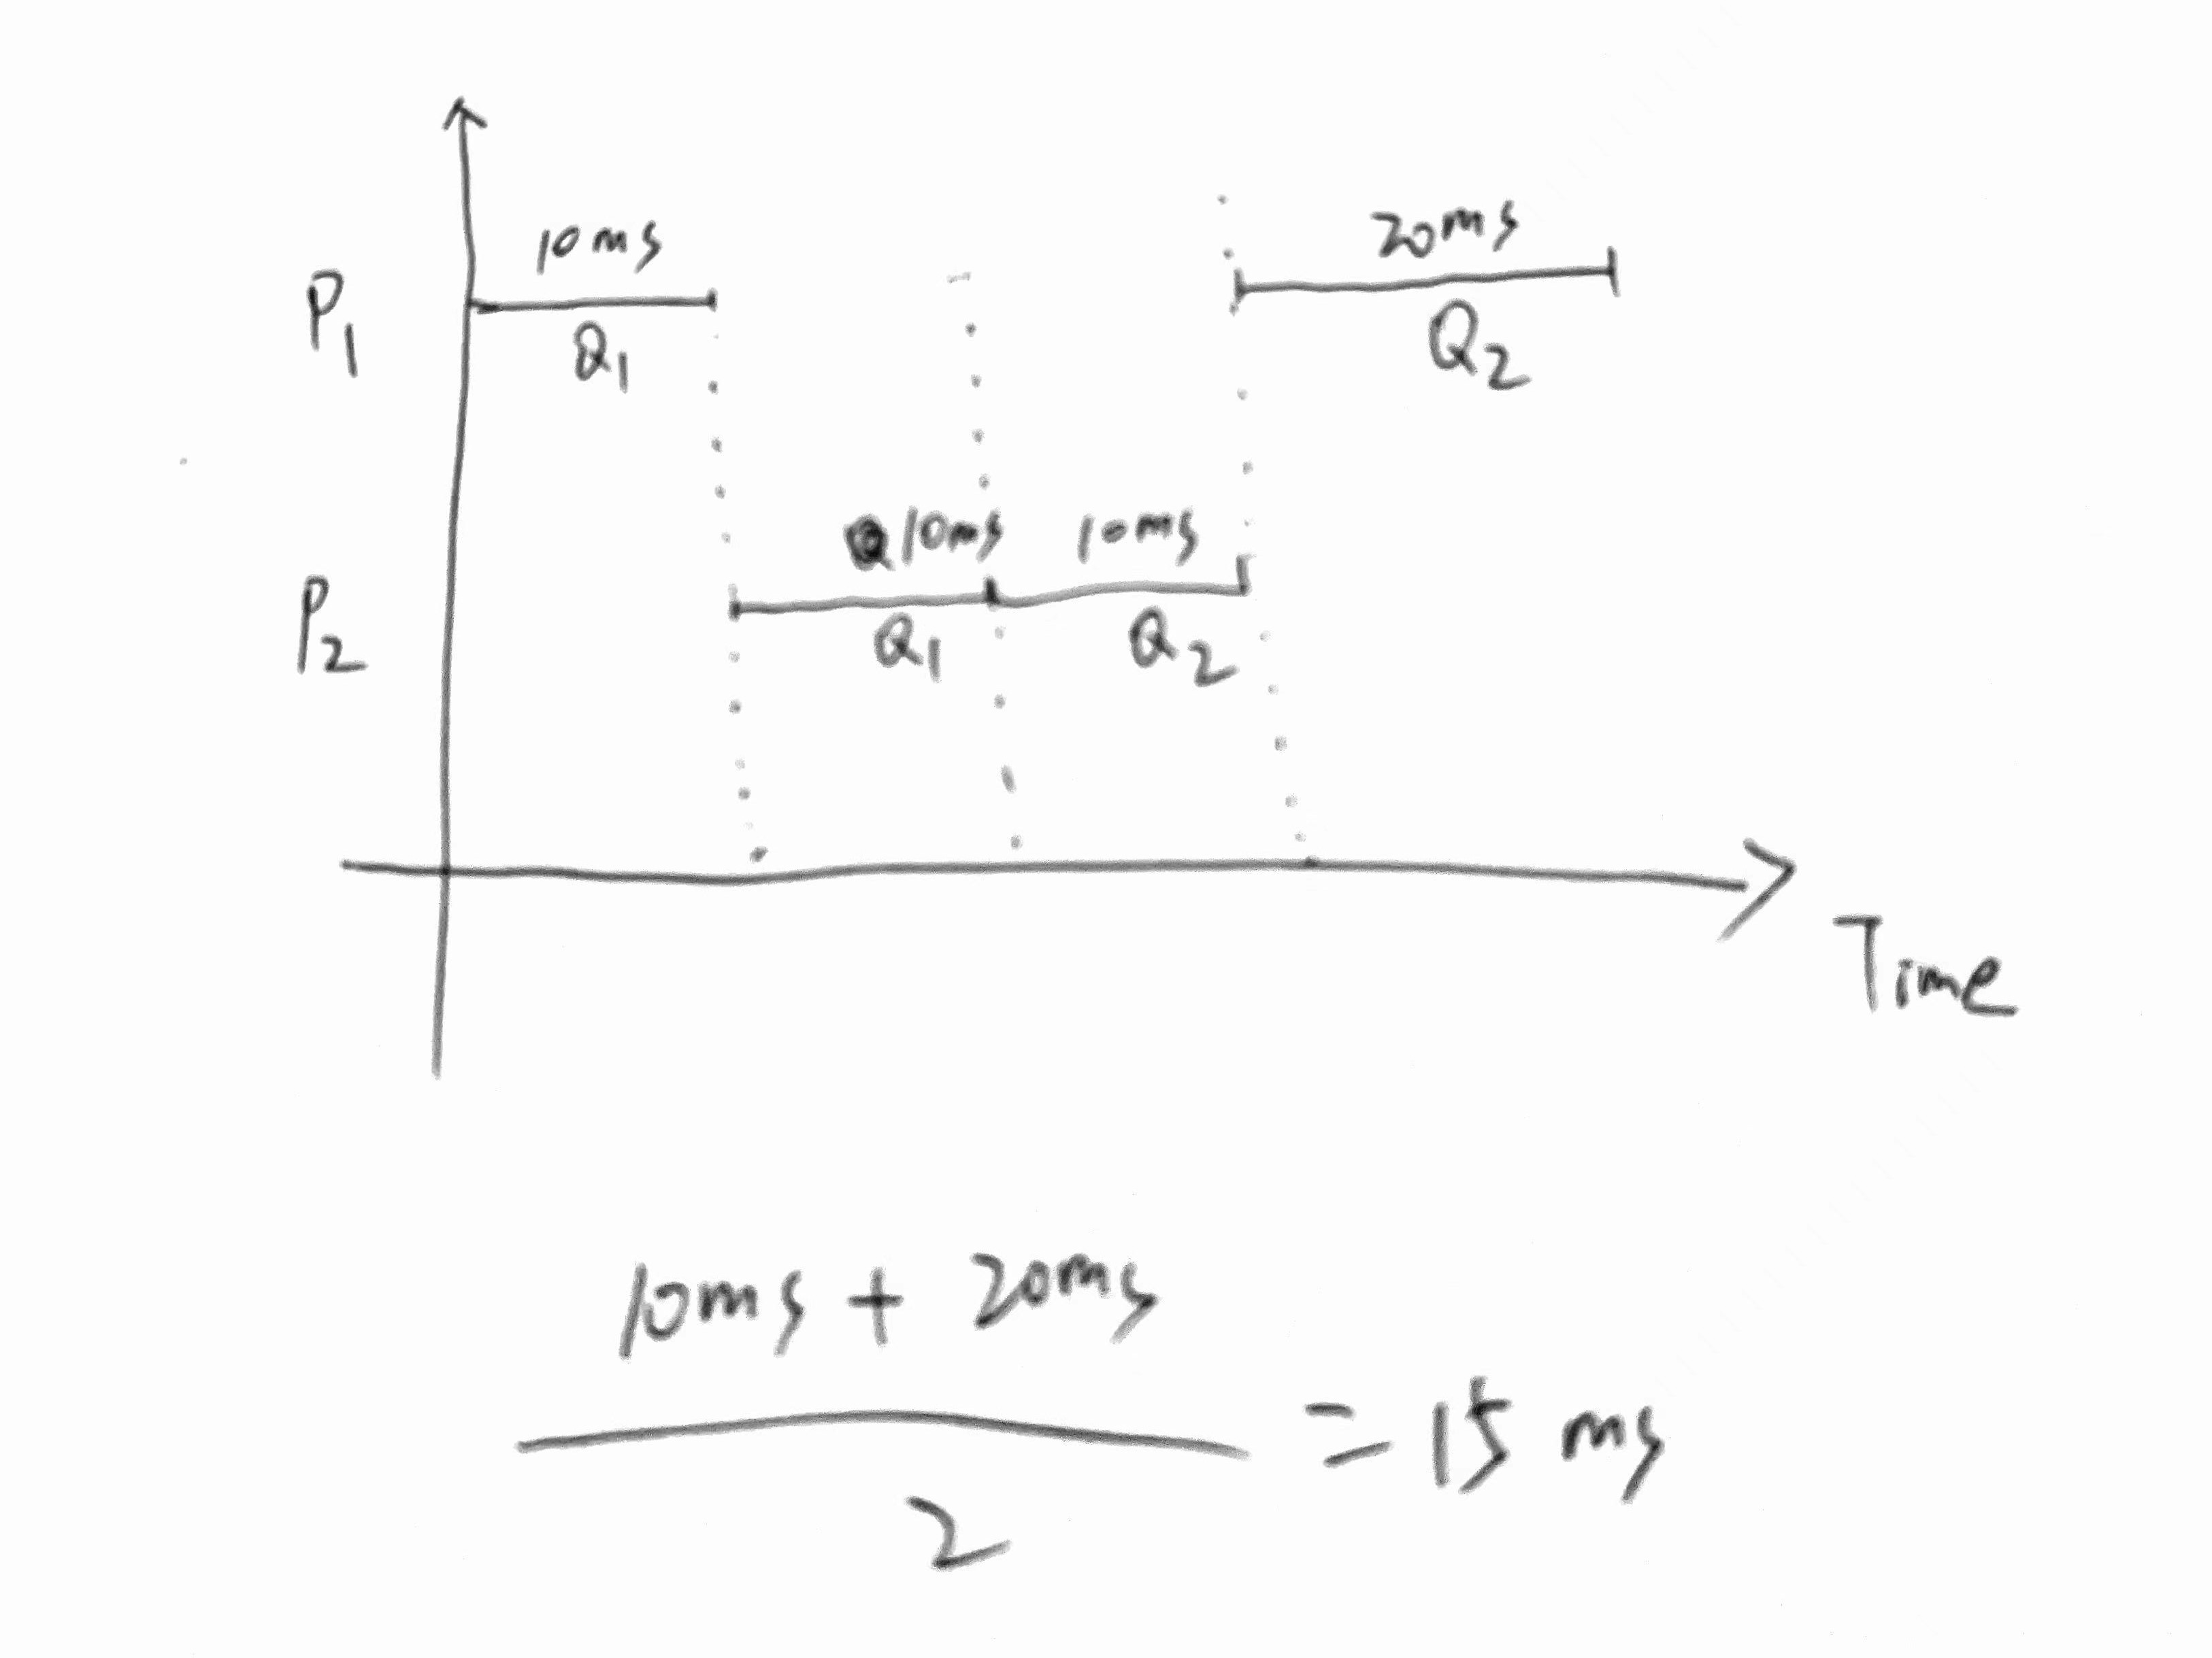
Quiz 4 - Solution

Slide 48
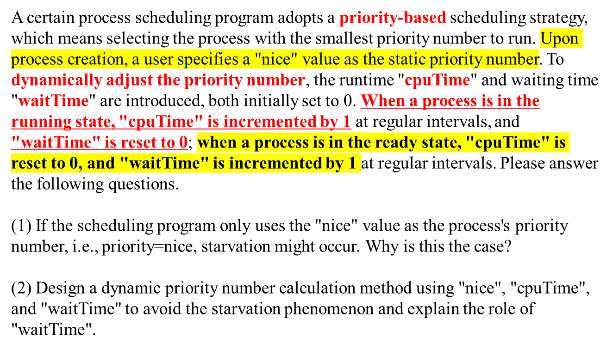
Quiz 5
Priority = nice + k1*cpuTime – k2*waitTime

Slide 49
End of Chapter 6

